Slide 1
Demand response curve
Relationship between Price and Demand

Slide 2
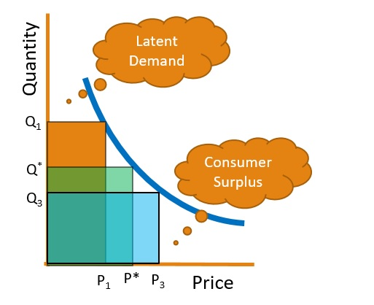
Basic economics

Slide 3
Demand response curve
A Function that describes how demand for a product D(p) varies as a function of its price
Similar to the Demand curve in Economics, but for a single seller, in a single market
Four properties
Non-negative
Continuous
Differentiable
Downward sloping

Slide 4
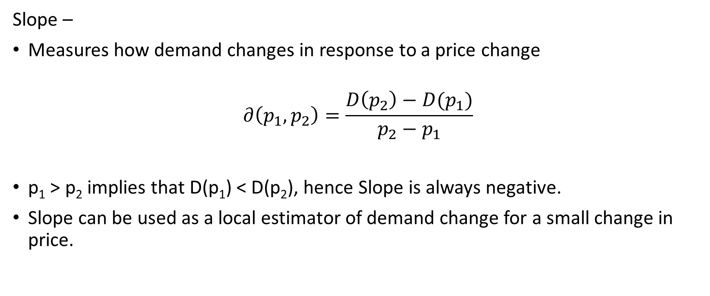
Price sensitivity
Slope –
Measures how demand changes in response to a price change
$$∂\left(p_{1},p_{2}\right)=\frac{D\left(p_{2}\right)−D(p_{1})}{p_{2}−p_{1}}$$
p₁ > p₂ implies that D(p₁) < D(p₂), hence Slope is always negative.
Slope can be used as a local estimator of demand change for a small change in price.

Slide 5
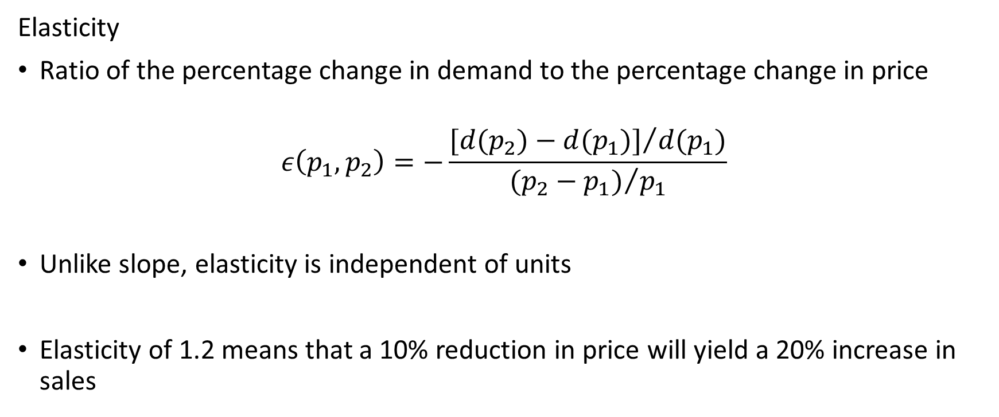
Price sensitivity
Elasticity
Ratio of the percentage change in demand to the percentage change in price
$$ε\left(p_{1},p_{2}\right)=−\frac{{[d(p_{2})−d(p_{1})]}/{d(p_{1})}}{{(p_{2}−p_{1})}/{p_{1}}}$$
Unlike slope, elasticity is independent of units
Elasticity of 1.2 means that a 10% reduction in price will yield a 20% increase in sales

Slide 6
Elasticity
Product | Short term elasticity | Long term elasticity
Salt | 0 | 0.1
Airline Travel | 0.1 | 2.4
Petrol | 0.2 | 0.7
Movies | 0.9 | 3.7
A two-wheeler | 1.2 | 0.2

Slide 7
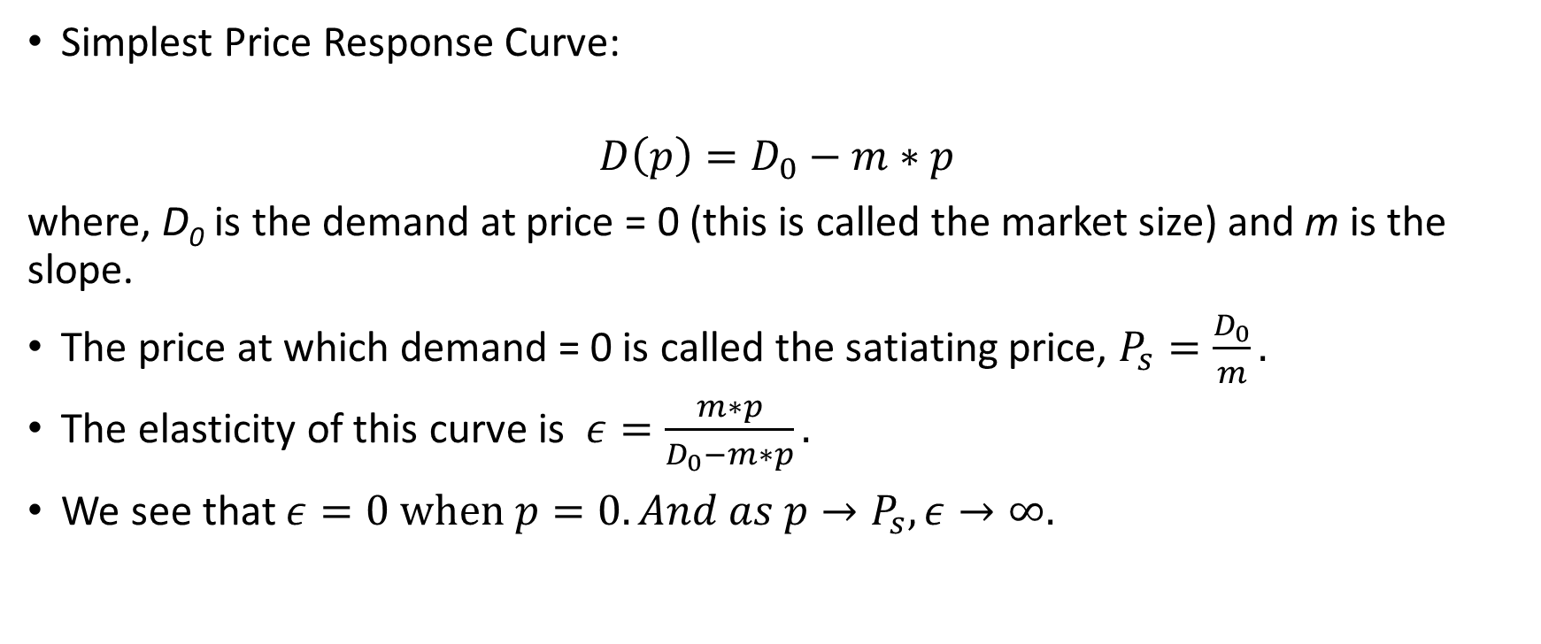
Linear response curve
Simplest Price Response Curve:
$$D\left(p\right)=D_{0}−m∗p$$
where, D₀ is the demand at price = 0 (this is called the market size) and m is the slope.
The price at which demand = 0 is called the satiating price, $P_{s}=\frac{D_{0}}{m}.$
The elasticity of this curve is $ε=\frac{m∗p}{D_{0}−m∗p}.$
We see that $ε=0 when p=0. And as p→P_{s}, ε→∞.$

Slide 8
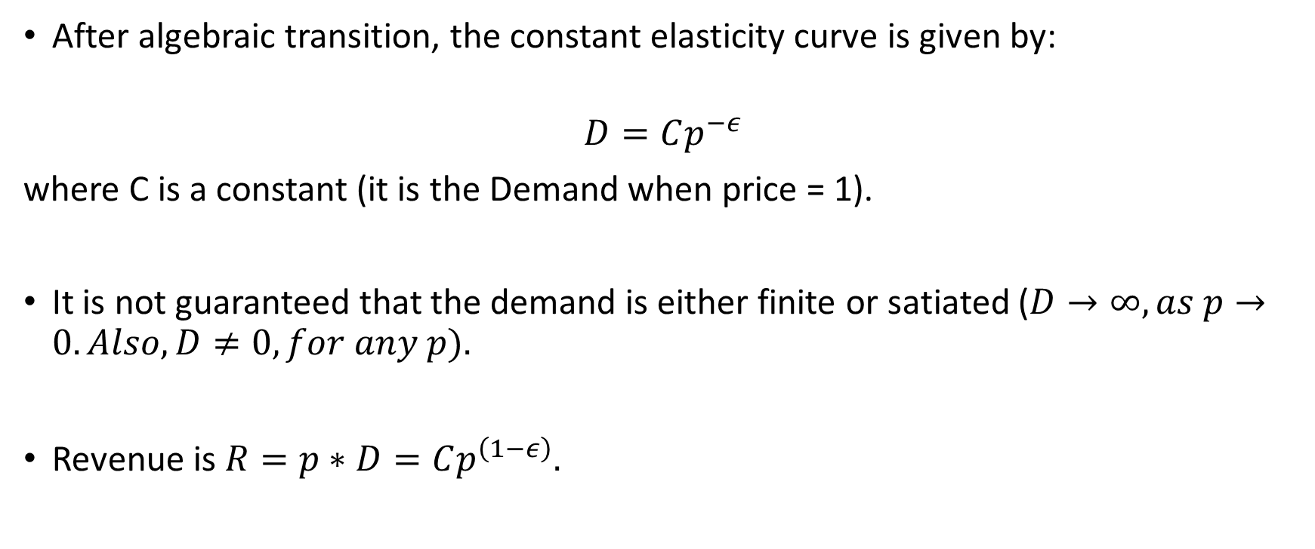
Constant elasticity curve
After algebraic transition, the constant elasticity curve is given by:
$$D=Cp^{−ε}$$
where C is a constant (it is the Demand when price = 1).
It is not guaranteed that the demand is either finite or satiated ($D→∞, as p→0. Also, D≠0, for any p).$
Revenue is $R=p∗D=Cp^{\left(1−ε\right)}.$

Slide 9

Constant elasticity curve
We notice that:
When $ε<1$, (inelastic product demand) the revenue can be increased by simply increasing the prices.
When $ε>1$(elastic demand) the revenue can only be increased by setting price close to zero.

Slide 10
Estimation problem
Assume that we conduct an market experiment where we offer different prices and check the realized demand at that time.
So we have the price offered and the corresponding demand values.
Price can be considered as an explanatory variable and the demand can be considered to be the dependent variable.
Can we estimate the slope and the elasticity?

Slide 11
Linear demand response curve
A SLR model can help identify D₀ (y-intercept) and m (the slope).
The SLR can tell us if the linear relationship is a good fit for the data available from the market experiment.
Please see the data and the corresponding SLR model.

Slide 12
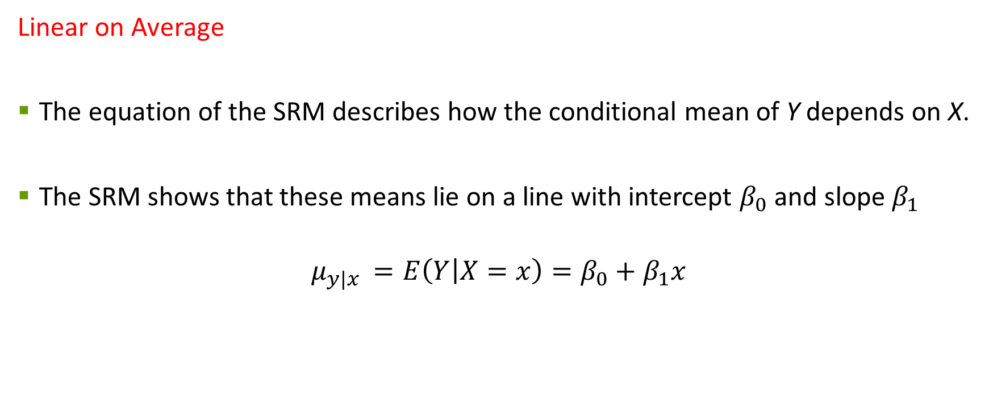
Simple Regression Model
Linear on Average
The equation of the SRM describes how the conditional mean of Y depends on X.
The SRM shows that these means lie on a line with intercept $β_{0}$ and slope $β_{1}$
$$μ_{y|x }=E\left(Y | X=x\right)=β_{0}+β_{1}x$$

Slide 13

Simple Regression Model
Deviations from the Mean
The deviations of responses around $μ_{y|x}$ are called errors.
Error, is denoted by $ε$, and $E\left(ε\right)=0$.

Slide 14
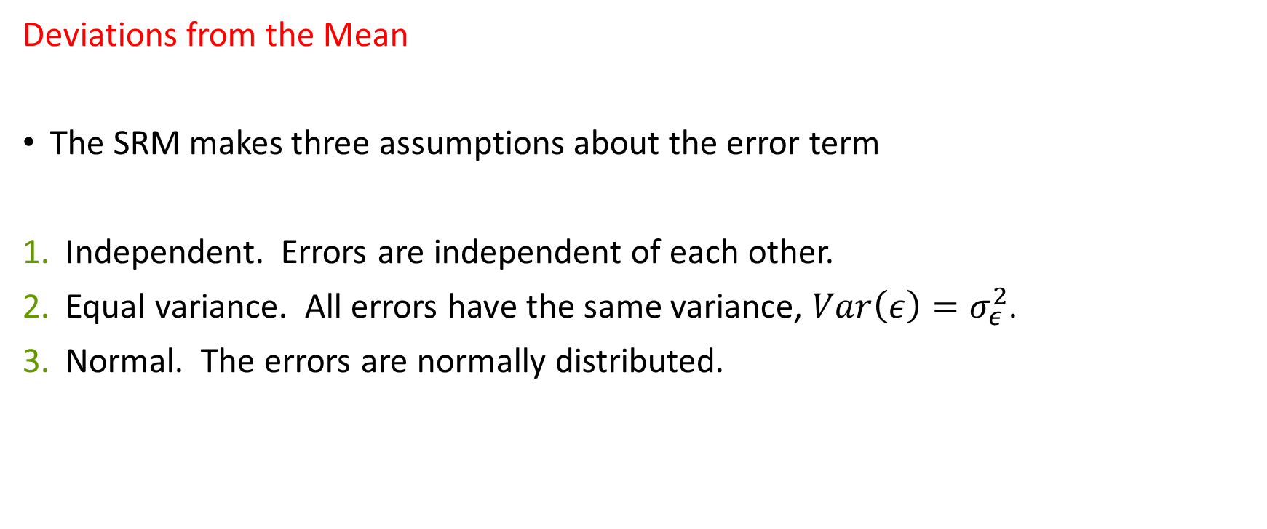
Simple Regression Model
Deviations from the Mean
The SRM makes three assumptions about the error term
Independent. Errors are independent of each other.
Equal variance. All errors have the same variance, $Var\left(ε\right)=σ_{ε}^{2}$.
Normal. The errors are normally distributed.

Slide 15
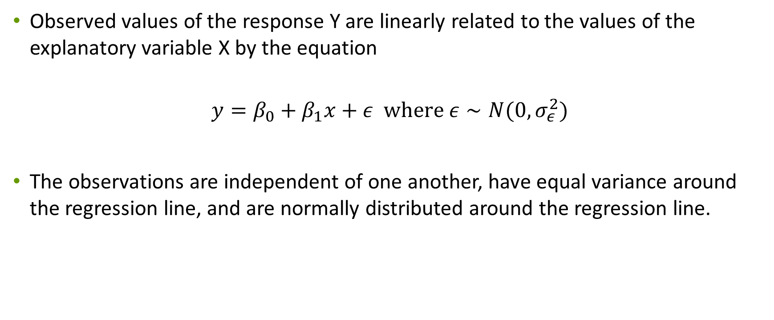
Simple Regression Model
Observed values of the response Y are linearly related to the values of the explanatory variable X by the equation
$$y=β_{0}+β_{1}x+ε where ε∼N(0, σ_{ε}^{2})$$
The observations are independent of one another, have equal variance around the regression line, and are normally distributed around the regression line.

Slide 16
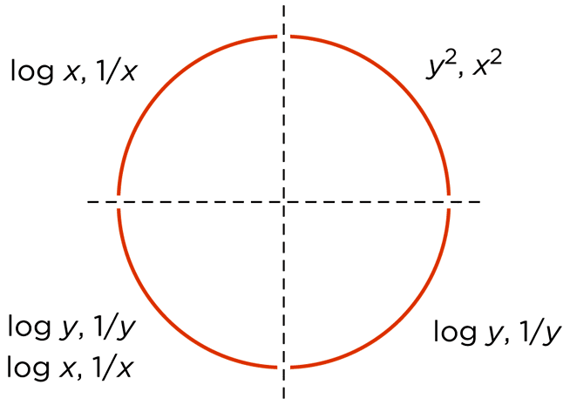
Constant elasticity model
The constant elasticity model is not linear.
Transformations allow the use of regression analysis to describe a curved pattern.
Select the correct transformation --

Slide 17

Constant elasticity model
Log-log transformation can convert the relationship to a linear one. And we get:
$$Log\left(D\right)=Log\left(C\right)−εLog\left(P\right).$$
An example of this is available in the Excel sheet.

